Slide 1
TREATMENT OF HYDROCEPHALUS (SHUNT PHYSIOLOGY AND PREVENTION OF INFECTION).

Slide 2
Hydrocephalous
An excessive accumulation of CSF within the head due to a disturbance of formation, flow or absorption
If left untreated the patient may develop increased intra-cranial pressure (ICP)
Result may be brain damage and/or death

Slide 3
Compliance and the Cranium
The brain and skull contain three primary components:
  Brain Tissue
  Blood
  Cerebrospinal fluid
A change in any one of these components results in adjustment to the other two which is called compliance

Slide 4
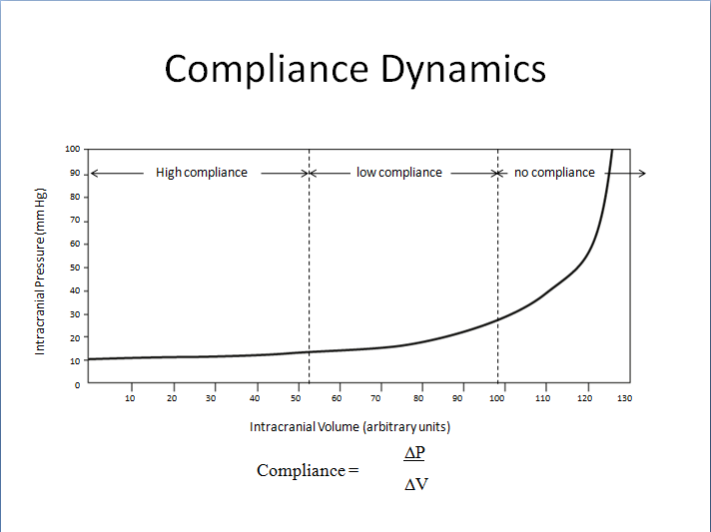

Slide 5
Cerebral Spinal Fluid (CSF)
CSF is produced mainly in the ventricular system by the choroid plexus and is present throughout the central nervous system
CSF has many functions:
  Remove waste
  Carry nutrition
  Regulation of brain function
  Neurotransmitter, paracrine and endocrine effects
  Cushions the brain

Slide 6
CSF Production & Absorption
CSF is produced at a rate of 20ml per hour and is normally absorbed at the same rate
The brain and spinal cord system contain approximately 150ml of CSF (25ml in the ventricles)
The entire CSF volume is turned over approximately 3 times per day
CSF is transferred from the subarachnoid space into the superior sagittal sinus (venous system) through small granulations called the arachnoid villa

Slide 7
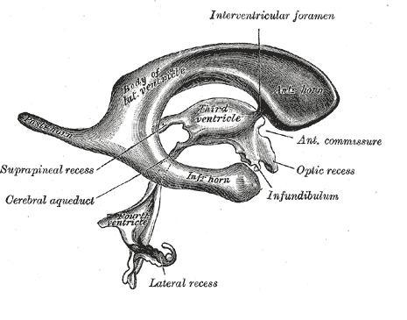
Gray anatomy 20th ed

Slide 8
2 Forms of Hydrocephalus
Communicating
  Full communication of CSF between ventricles and the subarachnoid space
Non Communicating
  CSF cannot flow out of the ventricles due to blockage or malformation

Slide 9
Compliance and Hydrocephalus
As discussed, the skull is a fixed vault with limited volume to hold brain tissue, blood, and CSF
If too much CSF exists, the blood and brain tissue are compressed or squeezed out resulting in a possible neurological deficit

Slide 10
Causes of Hydrocephalus
Acquired hydrocephalus (secondary)
  Tumors and cysts
  Inflammation (meningitis)
  Absorption blockages
    Sub Arachnoid Hemorrhage (SAH)
    Normal Pressure Hydrocephalus (NPH)
    Head injury
    Aqueductal Stenosis
Idiopathic hydrocephalus (primary)
  iNPH

Slide 11
Causes of Hydrocephalus
Foramen of Monro Gliosis Colloid cysts | Absorptive obstruction arachnoiditis (posthemorrhagic) (postmeningitic) venous thrombosis
Third ventricle chismal ghiomas craniopharyngiomas arachnoid cysts | Pineal region Tumors
Fourth ventricle medullobIastomas ependymomas astrocytomas Dandy-Walker cysts | Cerebral aqueduct aqueductal stenosis Aqueductal forking Subependymal gliosis periaqueductal gliomas
Basilar obstruction arachnoiditis Chiari malformations

Slide 12
Symptoms of Hydrocephalus
Usually associated with high intracranial pressure (ICP)
  Headaches, nausea, vomiting, sleepiness, irritability, seizures, downward deviation of the eyes, blurred vision, failing mental function, other problems
In infants - expanded head or bulging fontanelles, “sunset sign”.

Slide 13
Pediatric Hydrocephalus
Pediatric Etiologies
  Intraventricular hemorrhage (IVH) occurs often in premature babies
  Congenital hydrocephalus
  Tumor

Slide 14
Adult Hydrocephalus
Adult Etiologies
  Normal pressure hydrocephalus (NPH)
  Sub arachnoid hemorrhage (SAH)
  Post-trauma, aneurysm
  Pseudotumor cerebri
  Adult onset of congenital hydrocephalus

Slide 15
CT/MRI CRITERIA OF HCP
Hydrostatic hydrocephalus suggested when-
The size of both temporal horns is >2mm in width ; sylvian, interhemispheric fissures and cerebral sulci are not visible. Or
Both temporal horn are >2mm and the ratio FH/ID>0.5

Slide 16
CT/MRI criteria contd..
Ballooning of frontal horns of lateral ventricles (Mickey mouse ventricles) and third ventricle.
Periventricular low density on CT or periventricular high intensity signal on T2w1 on MRI suggesting transependymal absorption or migration of CSF

Slide 17
CT/MRI criteria contd..
Used alone- FH/ID
<40% - Normal
40-50%- borderline
>50% - HCP
Evans Ratio- Ratio of frontal horn to maximal biparietal diameter>30%.
Sagittal MRI may show upward bowing of corpus callosum.

Slide 18
Treating Hydrocephalus
Medical Management.
Spinal Tap.
Surgical Management

Slide 19
Medical treatment
Diuretic therapy- Tried in infants with bloody CSF to see if there is any resumption of normal CSF absorption.
Acetazolamide and furosemide started simultaenously.
To counteract acidosis start alkasol(2meq of K+/ml,no Na +)
S/E- electrolyte imbalance, lethargy, tachypnea, diarrhoea, paraesthesia.

Slide 20
Spinal Taps
HCP after intraventricular hemorrhage may be transient serial taps may temporize until reabsorption resumes but LP can only be performed for communicating HCP.
If reabsorption does not resumes when protein is <100mg/dl then it is unlikely to start as before.

Slide 21
Surgical treatment
Goal- “Optimum neurologic function and good cosmetic result” not “normal sized ventricles.
Options-
Eliminating the cause of obstruction.
Endoscopic methods.
Shunting.

Slide 22
Endoscopic - 3rd Ventriculostomy
Indications-
Obstructive HCP.
Shunt infection(removal of hardware).
Patients with subdural hematomas (shunt removed before TV is performed).
Slit ventricle syndrome.
Contraindication- Communicating HCP.

Slide 23
Endoscopic - 3rd Ventriculostomy contd.
Complications-
Hypothalamic injury.
Transient 3rd and 6th nerve palsies.
Uncontrollable bleeding.
Cardiac arrest.
Traumatic basilar artery aneurysm.

Slide 24
3rd Ventriculostomy contd.
Success rate- overall=56% (range is 60 to 94% for nontumoral aqueductal stenosis). Success rate is lower in infants as they may have under developed sub arachnoid space.
Lower success rate – if preexisting pathology present like- tumor, previous shunt, previous SAH, WBRT, adhesions.

Slide 25
Endoscopic choroid plexus coagulation
First done by Dandy(open)
Indications-
Communicating slowly progressing HCP in infants- 64% cured.
Choroid plexus papilloma/hyperplasia.
Necrotizing enterocolitis.
Intractable shunt failure.
Contraindication- Obstructive HCP.

Slide 26
Endoscopic fenestration
Septostomy – for U/L HCP
Multiloculated HCP.
Aqueductoplasty or aqueductal stenting.
Cysts with secondary HCP- Arachnoid cyst, Cysticercal cysts (3/4 ventricle)
Colloid cyst of third ventricle.
Pineal region tumors- ETV + Biopsy

Slide 27
Types of shunts
VP shunt
VA shunt
Torkildsen shunt- ventricles to cisternal space.
Miscellaneous– Ventriculopleural, gall-bladder, ureter or bladder.
LP shunt
Cyst or subdural shunt

Slide 28
Shunting
Surgical Goal
  Re-direct CSF to another area of the body to normalize ICP
Shunt Considerations
  Choose the correct operating pressure (fixed pressure valve)
  Avoid catheter obstruction
  Avoid shunt infection
  Avoid other issues
    Blood, high protein in CSF
    Catheter disconnection

Slide 29
Surgical Procedure
The surgical procedure to place a shunt is relatively short and uncomplicated:
  Incision in the scalp
  Small burr hole on the skull (6-9mm)
  Insertion of the ventricular catheter
  Incision in the peritoneal cavity
  Tunneling under the skin
  Closure

Slide 30
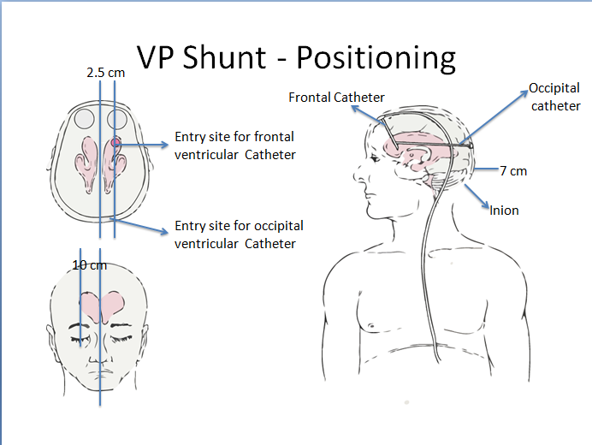

Slide 31
VA Shunt
Repeated lengthening required in a child.
Higher risk of infection and septicemia.
Possible retrograde blood flow into valves.
Shunt embolus.
Vascular complications-thrombophlebitis, pulmonary emboli, PHT

Slide 32
LP Shunt
Do not use in child- laminectomy causes scoliosis, risk of progressive scoliosis
Overshunting. May cause 3rd and 6th CN palsies.
Difficult access to proximal catheter for revision.
Lumbar root irritation.
Leakage of CSF around catheter
Pressure regulation is difficult.
Arachnoiditis.

Slide 33
Torkildsen shunt
Shunts ventricles to cisternal space.
Rarely used.
Effective only in acquired obstructive HCP as children with cong HCP frequently do not develop normal sub arachnoid CSF pathways.

Slide 34
Ventriculopleural shunt
Viable alternative if peritoneum is not available.
Risk of hydrothorax requiring relocation of distal catheter.
Recommended only for >7 yrs of age.

Slide 35
Disadvantages/complications of various shunts
Those that may occur with any shunt-
Obstruction –M.C. , proximal catheter>valve/distal catheter(12-34%)
Disconnection
Infection
Hardware erosion through skin.
Seizures-5.5% in I yr, 1.1 %/yr after 3 Yr.(Higher in frontal catheter.)
Conduit for extraneural mets.
Silicone allergy.

Slide 36
VP shunt complications
Inguinal hernia– if inserted when processus vaginalis is patent.
Requires long catheter to compensate for child growth.
Peritoneal end obstruction-more with distal slit valves, by peritoneal pseudocyst, Peritoneal adhesions may decrease absorptive surface, catheter malpositioning.

Slide 37
VP shunt complications contd..
Peritonitis
Hydrocele
CSF ascites
Tip migration –Into scrotum, viscus perforation, through diaphragm.
Intestinal obstruction.
Volvulus
Intestinal strangulation- shunt removed forcibly.
Overshunting.

Slide 38
Shunt Complications -INFECTIONS
Incidence -1.5 to 38%(International society of pediatric neurosurgeons cooperative study 1994- 6.5%)
Mortality, morbidity, costs.
Time to infection- 92% infections occur within three months.

Slide 39
Shunt Complications –INFECTIONS contd..
Risk factors-
Age – most important. (Different skin flora, less immunity and IgG).
Reason for shunt placement.
Type of shunt.
Educational level of surgeon.
Presence of spinal dysraphism.(50% children with MMC who were shunted within 1 wk developed shunt infection.)

Slide 40
Shunt Infections contd..
Presentation-
Headache,lethargy,nausea and vomiting.
Infants- irritability, severe- apnea and bradycardia.
Fever, gait disturbance, seizures, visual disturbances, upgaze palsy, papilledema, abdominal pain-swelling.
E.coli-severe abdominal pain & septicemia, Staph- indolent , erythema along tract.

Slide 41
Shunt Infections -
Evaluation and diagnosis
History and examination (D/D specially in children- URI, gastroenteritis, UTI, Appendicitis)
Imaging-
X ray(shows disconnection of the system.)
USG – Cranium (ependymal enhancement), abdomen.
CT scan
Shunt tap- CSF and manometry

Slide 42
Shunt tap
Indication-
Diagnosing infection/cytology/remove blood/check function/inject medication.
2. Steps-
Insert a 25 gauge butterfly canula and look for flow. Measure pressure.
Measure pressure with distal occlude pressed.
If no spontaneous flow , try to aspirate CSF with a syringe.
Send CSF sample
Connect with manometer.
Repeat measurement after injecting 3-5 ml of saline.

Slide 43
Shunt Infections -Prevention
Sterile surgical technique.
Haines and Walters have found 50% reduction in infections with use of prophylactic antibiotics.
Antibiotic impregnated shunt tubing.
Use of antibiotics before dental procedures, one piece system, biannual screening, hypothermia during surgery.

Slide 44
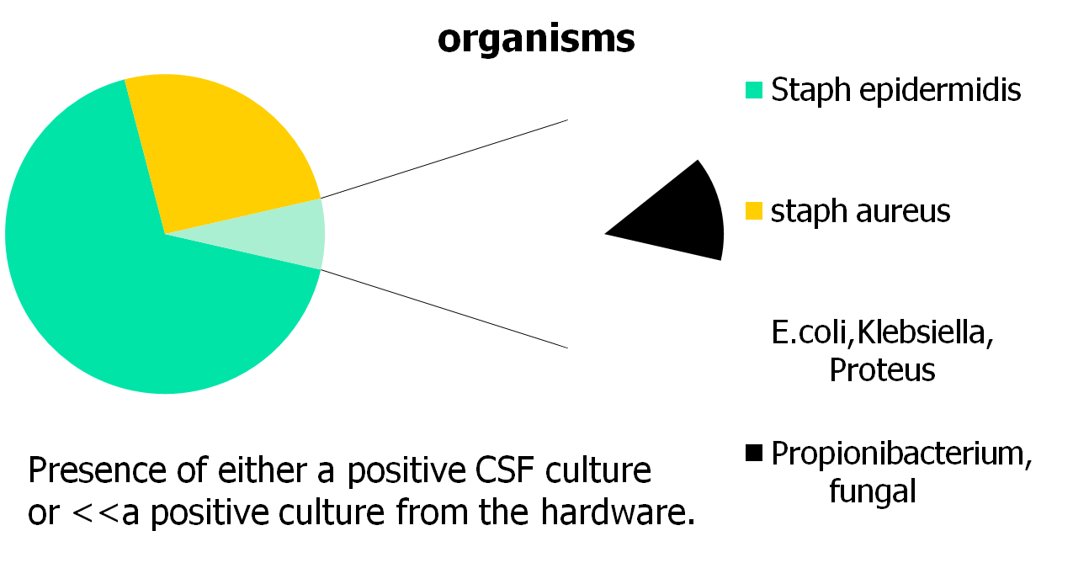
Shunt Infections -Organisms

Slide 45
Shunt Infections -Treatment
Medical
IV+IT+VENT
IV ABs
Surgical
Replacement
externalize
Removal

Slide 46
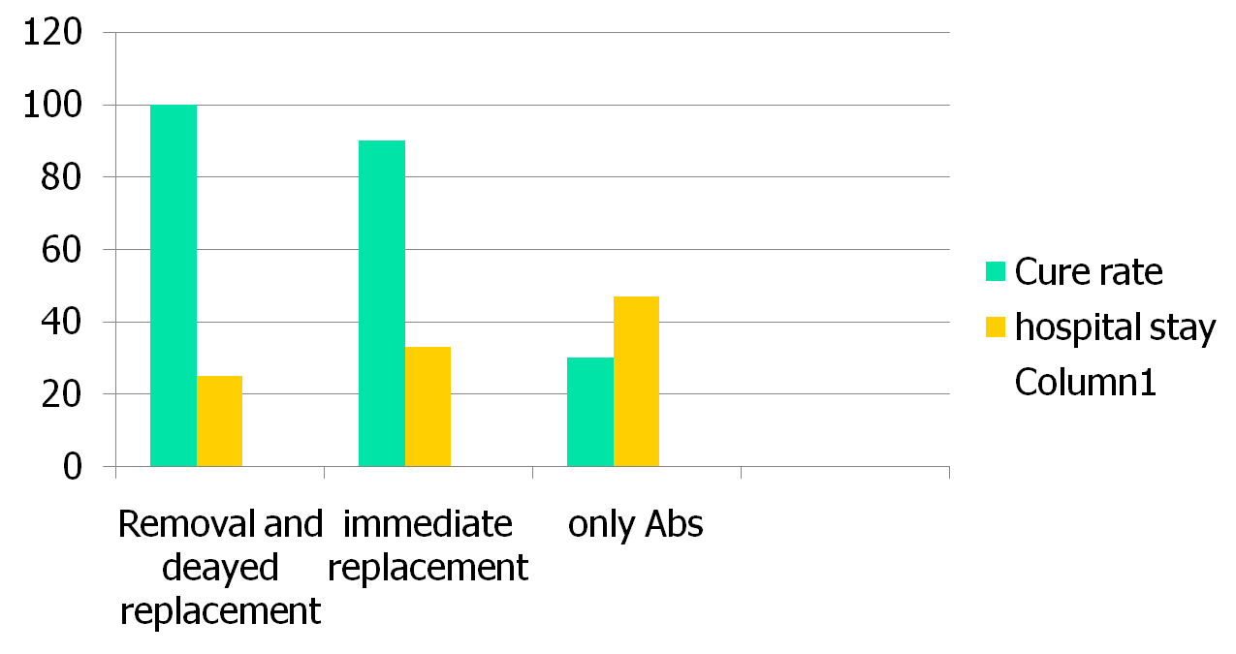
Treatment outcomes
Frame & McLaurin –J neurosurgery.

Slide 47
Shunt Complications- Overshunting
10-12%,VP shunt>VA SHUNT(SIPHONING)
Slit ventricle
Subdural hematoma
Craniosynostosis
Aqueductal stenosis/occlusion
Intracranial hypotension

Slide 48
Undershunting
Shunt malfunction rate 17% in I yr.
Cause- blockage (choroid plexus/proteinaceous material/blood); Disconnection.
Symptoms-H/A,N/V, diplopia, lethargy, ataxia, infants, seizures.
Signs-upward gaze palsy, 6th CN palsy, field cut, papilledema.

Slide 49
Shunt Complications (continued)
Disconnection
A part of the system becomes disconnected. The connections between catheters, valves or accessories are damaged. Sometimes due to growth of the patient.
Bowel Perforation
The distal/peritoneal catheter perforates the bowel. Must be revised.

Slide 50
Physiology of shunt devices
History- hippocrates probably did first ventricular puncture. Nulsen and Spitz did the first ventriculojugular Shunt.
Hydrodynamics-
Flow= P/R
R=8nL/^R4
P=IVP+PGH-OPV-DCP.

Slide 51
Shunt physiology-
Siphoning- Difference in the height of ventricular catheter and that of the distal catheter, causes pressure differential equal to pgh.
Hysteresis- It occurs d/t slight change in the mechanical properties of the valves, depending on whether they are opening or closing. Seen with Slit and miter valves.

Slide 52
Shunt Systems
Shunt systems come in a variety of configurations and models but they have similar functional components:
  Valve Mechanisms – flow or differential
  Fixed, programmable, or variable settings
  Catheters
    Ventricular (proximal)
    Peritoneal/Atria (distal)
  Accessories
    Reservoirs, Siphon Devices
    Connectors, Filters, Pumping Chambers

Slide 53
Shunt Components - Catheters
Ventricular Catheters
  Placed in the ventricles to deliver CSF to the Valve or Distal Catheter
  A series of holes in the ventricular catheter allows CSF to enter the shunt system

Slide 54
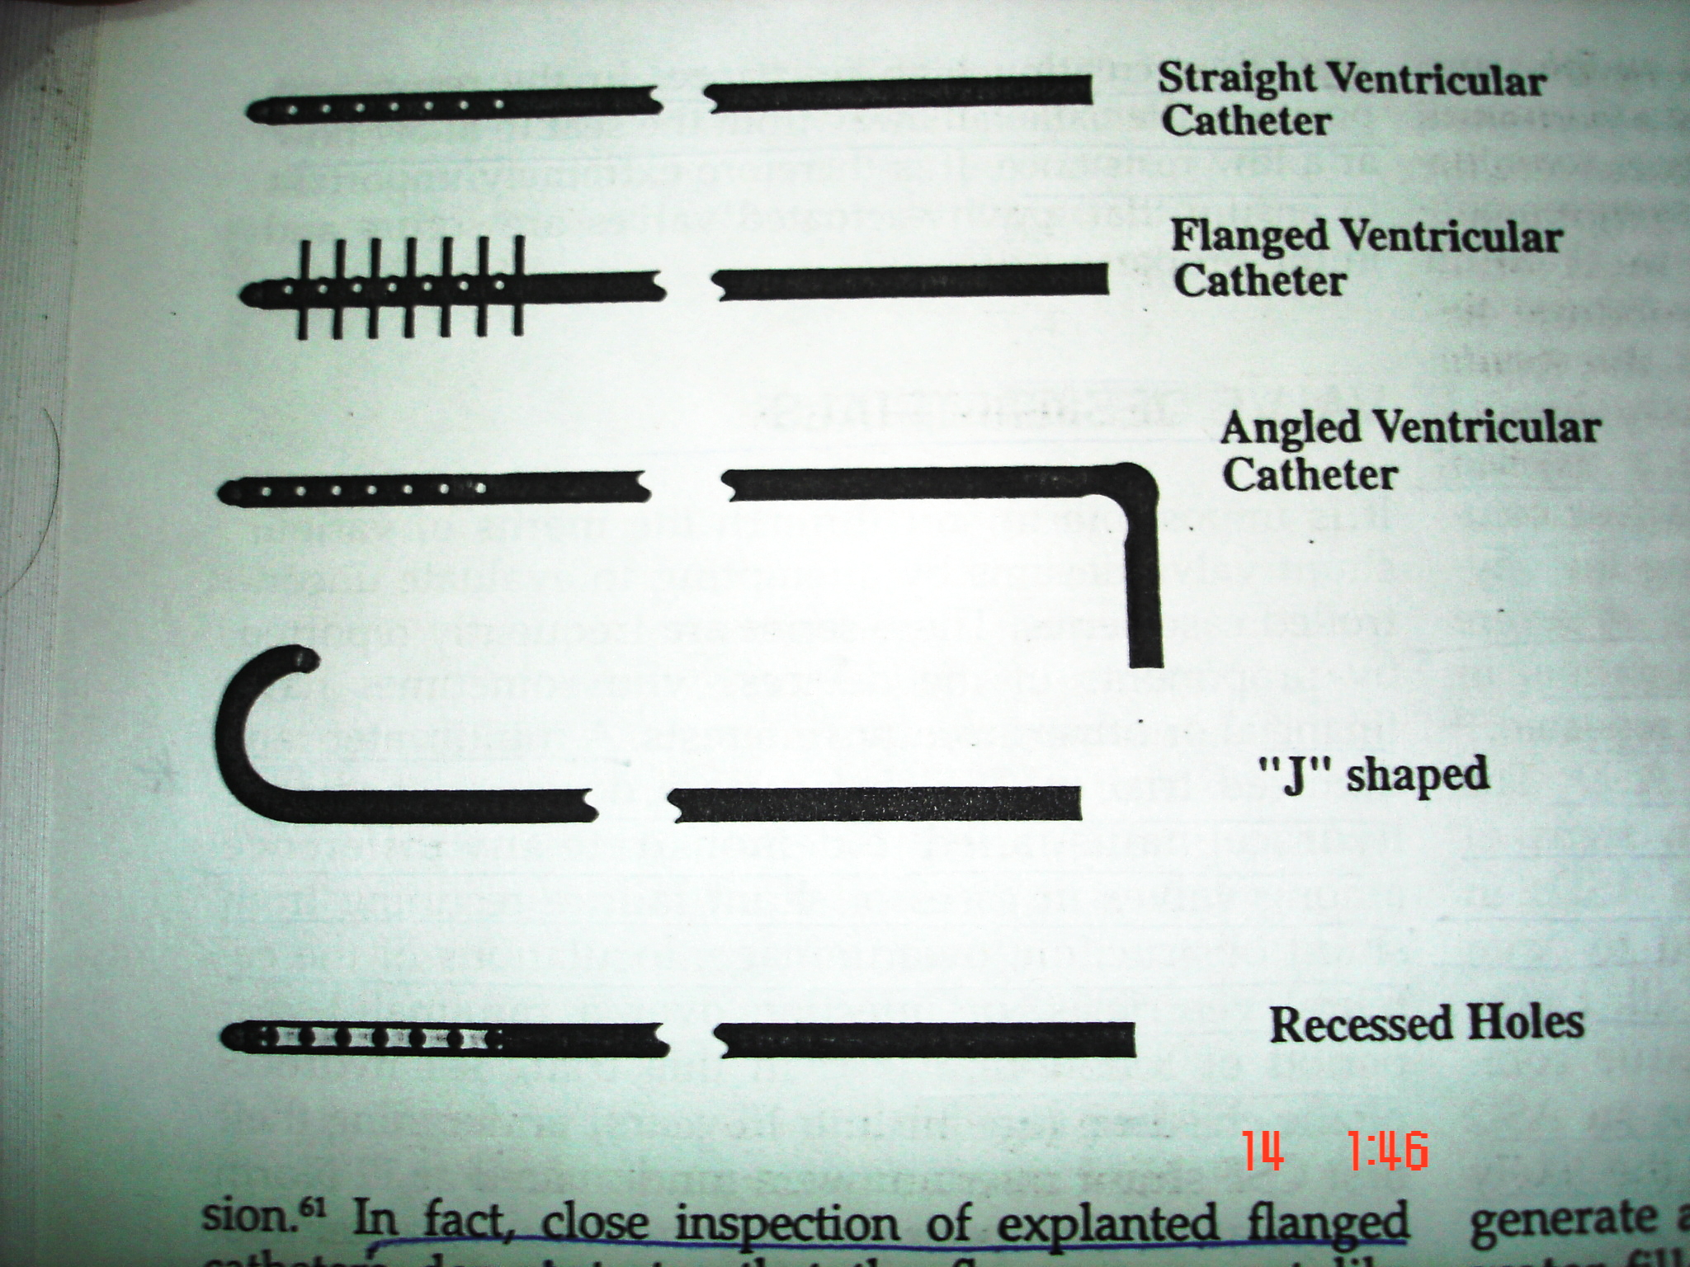
Types of ventricular catheters

Slide 55
Shunt Components - Catheters
Distal Catheters
  The distal tubing is made of silicone and has got slit valves near the distal end with close ended tube or open ended. Valves function when open end gets blocked.

Slide 56
Shunt Components - Valves
Valves
  Mechanism which helps regulate the ICP by redirecting enough CSF distally. The valve must provide the optimal balance of CSF diversion, not under drain or over drain the ventricles.
  The valves are one way and have operating pressure ranges or opening pressure settings.

Slide 57
Valve Basics
Proximal Valves
  Valves placed close to the ventricles
Distal Valves
  Valves placed in the peritoneum, away from the ventricles

Slide 58
Shunt valves
Differential pressure valves
Slit valves (distal or proximal)
Mitre Valves (Hysteris occurs).
Diaphragm Valves (Most common).
Ball in Cone Valves.
Defined by their opening pressure.

Slide 59
Flow regulated valves
Designed to increase the hydrodynamic resistance as the pressure gradient increases. Keep flow rate constant.
Less likely to be associated with siphoning, but due to small orifice have higher chances of getting obstructed.
Eg. Orbis sigma valve.

Slide 60
Gravity actuated valves
Gravity actuated valves attempt to prohibit or reduce siphoning by increasing opening pressure with assistance of gravity when patient sits up.
Eg. Cordis Horizontal vertical valve for use with LP shunt.

Slide 61
Antisiphon devices
This device is typically placed under the scalp has a small diaphragm that reduces the rate of CSF flow when pressure inside the shunt falls below atmospheric pressure.

Slide 62
Why a Programmable Valve?
Flow = Δ p / R
200 mmH₂O
Δ p =ICP - OP + HP - PP
30 mmH₂O
Patient dependant (age, physiology,…)
Time dependant (activity, growth, adaptation…)

Slide 63
Adjustable Valves
Valve Mechanism allows you to change operating pressure non invasively
Codman Valve
  Codman Programmable Valve
  18 pressure settings

Slide 64
Valve Components
Ball & Seat - Synthetic Ruby
Baseplate - Titanium
Cam - Polyethersulfone
Stator – (Nickel alloy)
Magnets – Samarium
Cobalt (SmCo)
Housing - Silicone
Spring - Stainless Steel

Slide 65
External Influences
Investigated During Device Development:
Vibration & Shock Studies
  Normal activity levels
RF Field Studies
  Household appliances, Cell phones, Airport security gates, ...
Strong Magnetic Fields Studies
  MRI units
  Strong household magnets

Slide 66
External Magnetic Fields
Magnetic field threshold for deprogramming
> 80 Gauss (1 step, “optimal” conditions)
Examples:
Headphone 50 Gauss at the surface
Household appliances < 10 Gauss
Magnetic Therapy Pillow >430 Gauss
1.5 Tesla MRI 15,000 Gauss
CHPV Programmer 325 Gauss
=> Unlikely the valve will be affected by everyday sources

Slide 67
Warnings / Precautions
Valve is supplied without a preset pressure and must be programmed prior to implantation
Aseptic surgical technique
Don’t flush, fill or pump valve with
lint-containing fluid
Take care to prevent shunt from touching surface
Don’t tie sutures tightly
Don’t move the transmitter during programming

Slide 68
X-Ray Verification
Shoot film perpendicular to the plane of the valve
Shoot film in relation to valve and not patient anatomy
Non-implanted site of patient’s head should rest on plate
Any angle other than 90 degrees may lead to misinterpretation of pressure setting

Slide 69
MRI Studies
Safe for use; “MRI Conditional”
  no movement of valve in tissue pocket
  no selective heating
  no effect on valve performance
MUST Reprogram after each MRI
  MRI will change the pressure setting

Slide 70
Post-Op Programming
New pressure setting determined by patient clinical symptoms
Locating valve mechanism - palpate hard plastic casing
Mark position of valve mechanism with finger or surgical market
Transmitter head placed directly over the CAM of valve mechanism.
Verify setting with VPV, x-ray or Fluoro

Slide 71
X-ray Verification
As illustrated below, there is a direct correlation between the position of the programming unit control panel pressure selector buttons and the position of the pressure indication on the valves as seen when x-rayed.
When the valve is programmed to 70, 120, or 170, the pressure indicator aligns with the “X” in the center of the valve.

Slide 72
X-Rayed Valve Information
The white marker on the valve (1) indicates the right hand side of the valve
  The marker will not be seen on the x-ray if it is positioned on a 30° angle or more; the valve cannot be programmed if the angle is 45° or more
The pressure indicator on the white ring (2) denotes the chosen pressure

Slide 73
Non X-Ray Verification
Clinical Need
  Minimize patient exposure to X-Rays
Clinician Performing the Reprogramming
  Improve ease of use
Methods Investigated
  Magnetic verification of valve setting
  Acoustic verification of valve setting
  Infrared laser
  Ultrasound
Notes:
We have heard from our CHPV users, that it would be an improvement to have a method to verify the valve setting without having to take an X-Ray.
I would like to get some feedback from you, what compels you to take an X-Ray with our Valve (you told me I had to , I need to know where the setting is)?
We know that the other adjustable valve uses magnetic designs and we looks at that, but avoided it due to unwanted outside magnetic influences.
We conducted extensive customer research and we decided to utilize acoustic technology, which makes all implanted valves compatible with this technology.

Slide 74
Antibiotic impregnated shunts
Bacteria In Shunting
  Most common bacteria in shunt infections?
    S. epidemidis
    S. aureus
    Coryneforms
    Streptococci
    Enterococci
Account for approx. 77% of shunt infections.

Slide 75
Antibiotic impregnated shunts
Effectivity
  It is not intended to be effective against all causative organisms for shunt infections.
  It is effective against the bugs that are susceptible to rifampicin and clindamycin.
  Rifampicin and clindamycin are effective against most strains of bacteria that cause shunt infections.

Slide 76
Antibiotic impregnated shunts
A shunt infection occurs when a pathogen attaches itself in or on the shunt
Majority of bacterial contamination is introduced at time of surgery
Infection becomes clinically evident in 3-4 weeks post op
Shunt infections can be both internal or external to the shunt

Slide 77

Internal or External ?
Internal
Majority
S. epidermidis or Coryneforms
External
Minority
Wound infection complicated by foreign body
S. aureus

Slide 78
Antibiotic impregnated shunt- contd
Colonization Process
Staph
Bacteria adhere to the silicone
The bacteria produce an extracellular slime
This slime adheres to the inner lumen surface of silicone catheters

Slide 79
Contd..
Internal Shunt Infection
The organisms start to multiply
And they produce extracellular slime
This can, in time, completely block the shunt

Slide 80
Antibiotic impregnated shunt
Ventricular and Distal Silicone Catheters
Impregnated with Two Antibiotics
      Rifampicin & Clindamycin
And they are ORANGE!!!

Slide 81
Contd.
How are They Made?
CHCl3
Matrix
contracts
trapping
drugs
inside
Normal
silicone
molecule
matrix
In chloroform
the matrix expands
Squeezed
in under
pressure
The antibiotics
fill the gaps

Slide 82

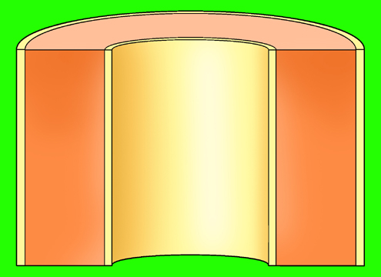
Contd.
How Do They Work?
CSF
CSF
Bacteria from the skin,
introduced during implantation are carried by the CSF and attach themselves to the catheter surface.
CSF

Slide 83
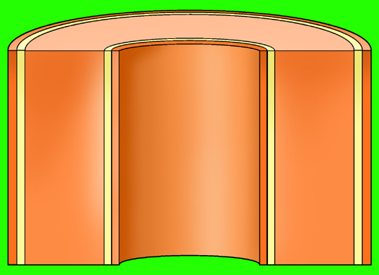

Contd.
How Do They Work?
CSF
Laboratory studies have
shown that the protective
effect is active for at least
28 days protection.
Most shunt infections
occur within the first month - having been
introduced during
implantation.
CSF

Slide 84
Contd..
How Do They Work?
CSF
Due to the concentration difference between the catheter and the external environment, there is a
positive diffusion gradient
which causes the drugs to slowly diffuse out of the silicone.
CSF
The concentration of drugs at the surface of the catheter is high enough to inhibit colonization.
CSF

Slide 85
Contd.
How Do They Work?
CSF
The concentration of drugs at the surface of the catheter is high enough to inhibit colonization.
CSF

Slide 86
Precautions
Pre Implant Technique
Surgeon should not pre soak Bactiseal in saline or antibiotic solutions prior to implantation because the diffusion process will be activated.

Slide 87
Precautions
Packaging
It is sterilized by autoclave
It cannot be sterilized in the same way as Valves
For this reason it cannot be supplied packed with a valve or unitised.
It must be stored in a temperature controlled environment not to exceed 80°F (27° C)

Slide 88
Why clindamycin and rifampicin?
These two antibiotics in combination have proven to be effective against the specific organisms that cause the majority of shunt infections.

